Slide 1
Lecture 33

Slide 2
Question 123.11.5
Which quantity is independent of path
Q
ΔE_{int}
W
Can’t tell

Slide 3
Question 123.11.2
You use Joule’s paddle apparatus to raise the temperature of a fluid. Is any heat involved?
Yes
No
Maybe

Slide 4
Question 123.11.1.5
You open your freezer (or a door in January in Rexburg), energy flows out. What is the sign of Q?
Positive
Negative
Other

Slide 5
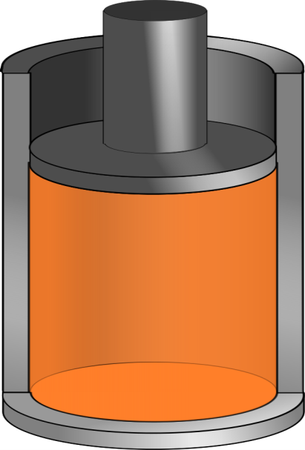
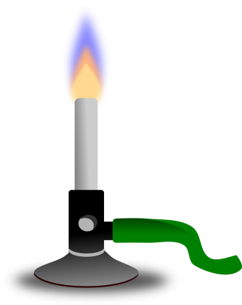
Q negative
Q positive

Slide 7
Question 123.11.3
You increase the temperature of a gas in a cylinder with a piston. Is there heat involved?
Yes
No
Maybe

Slide 8
Question
What is not changing in the process shown in this PV diagram?
Pressure
Volume
Number of Moles
The Universal Gass Constant
Temperature

Slide 12
Question
What do we call a process where the volume doesn’t change?
Isobaric
Isochoric
Adiabatic
Isothermal

Slide 13
Question
What is not changing in the process shown in this PV diagram?
Pressure
Volume
Number of Moles
The Universal Gass Constant
Temperatuere

Slide 16
Question
What do we call a process where the volume doesn’t change?
Isobaric
Isochoric
Adiabatic
Isothermal

Slide 18
F_{p,air}
F_{p,gas}
F_{g}

Slide 19
Question
What is not changing in the process shown in this PV diagram?
Pressure
Volume
Number of Moles
The Universal Gass Constant
Temperature

Slide 21
Question
What do we call a process where the volume doesn’t change?
Isobaric
Isochoric
Adiabatic
Isothermal

Slide 22
A

Slide 23
Question 123.11.4
You put a gas in a cylinder with a piston through a process that changes the temperature. Can Q=0?
Yes, if it is the right process
No
Maybe

Slide 24
END

Slide 25
Carnot Engine

Slide 26
A
D
B
C

Slide 27
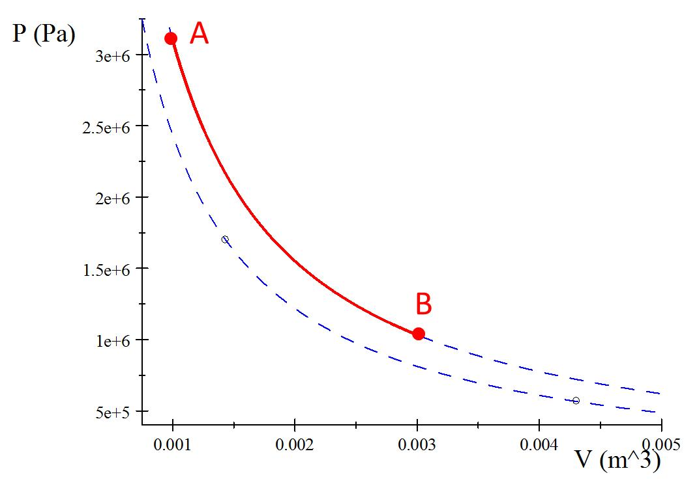

Process A to B
Q_{h}

Slide 28
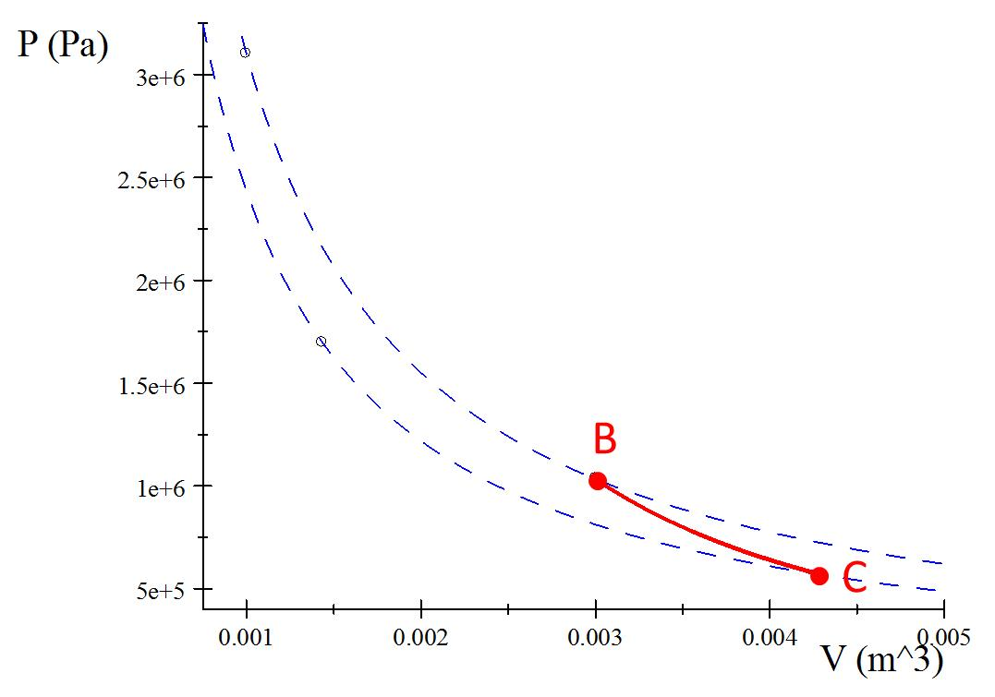
Process B to C
Insulator

Slide 29
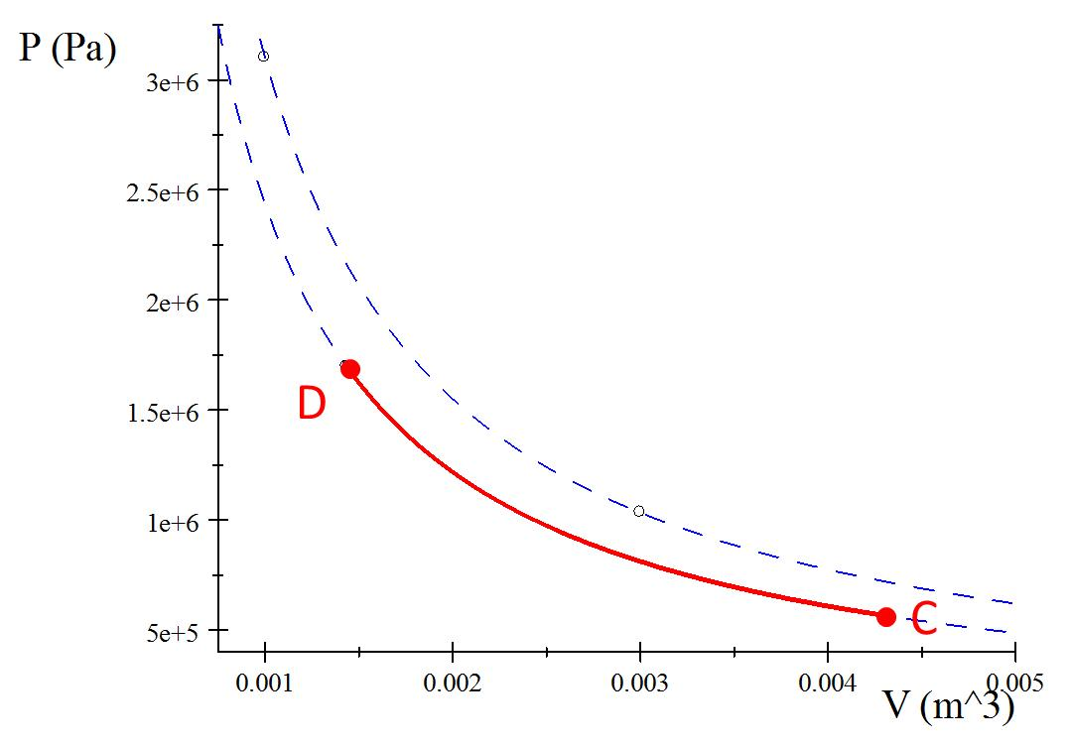
Process C to D
Q_{c}

Slide 30
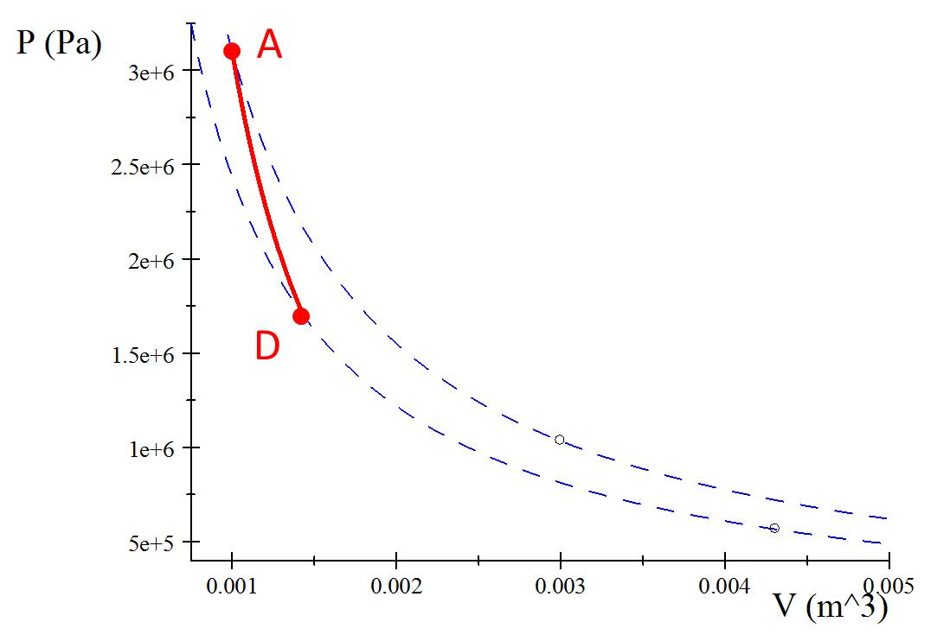
Process D to A
Insulator

Slide 31
A
B
C
D

Slide 32
Process A’B
A
B
Q_{h}

Slide 33
Process B’C
B
C
Insulator

Slide 34
Process C’D
D
C
Q_{c}

Slide 35
Process D’A
A
D
Insulator

Slide 36
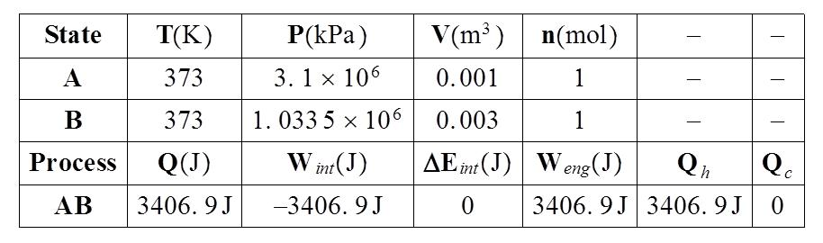

Slide 37





Identify the type of process
Write out the special equations for that process
Symbolically solve for ΔE, Q, W, P, V, and T
Identify your contribution to Q_{h} and Q_{c}
Fill in with numbers
$$V_{A}=0.001m^{3}$$
$$V_{C}=0.015m^{3}$$
$T_{A}=1023$K
$$T_{C}=293\text{K}$$
$n=$1mol

Slide 38
A
B
C
D

Slide 39
A
B
Q_{h}
Q_{c}
C
D

Slide 41


Identify the type of process
Write out the special equations for that process
Symbolically solve for ΔE, Q, W, P, V, and T
Identify your contribution to Q_{h} and Q_{c}
Fill in with numbers
$$V_{A}=0.001m^{3}$$
$$V_{C}=0.00431m^{3}$$
$T_{A}=373$K
$$T_{C}=293\text{K}$$
$n=$1mol

Slide 42
A
D
B
C

Slide 43
A
Q_{h}
D
B
Q_{c}
C

Slide 44
A
B

Slide 45
B
C

Slide 46
D
C

Slide 47
A
D

